Slide 1
SWE-4805: Software Verification and Validation
V & V model
Md. Nazmul Haque
Lecturer, IUT
Department of Computer Science and Engineering
Islamic University of Technology
December 21, 2021

Slide 2
Contents
Contents
Introduction to V & V model
Description of V & V model

Slide 3
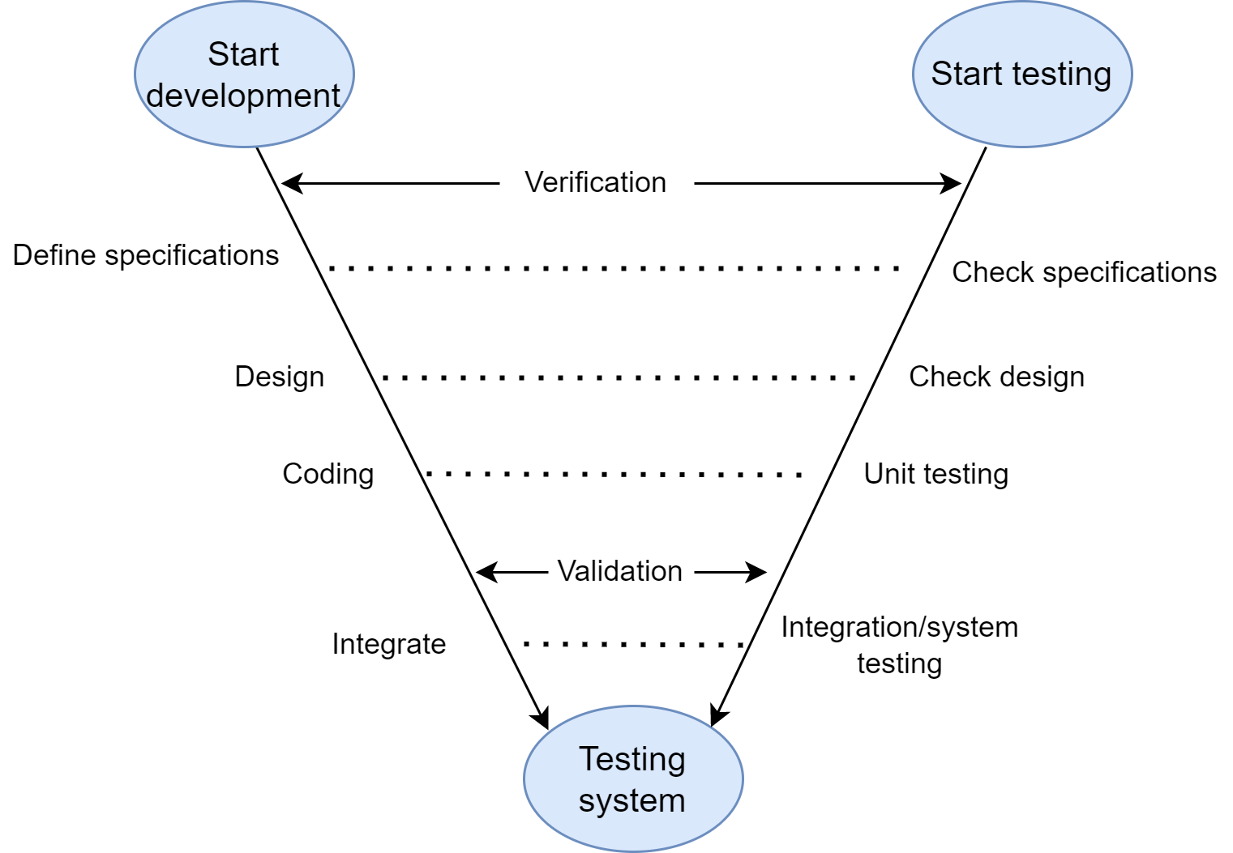
Verification
V & V in Testing
Fig: V-Testing

Slide 4
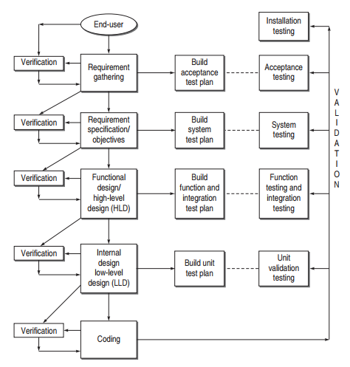
Verification
V & V in Testing

Slide 5
Verification
Verification
Verification is static analysis technique where testing is performed without executing the code.
Verification Activities
Verification of Requirements and Objectives
Verification of High-Level Design
Verification of Low-Level Design
Verification of Coding (Unit Verification)

Slide 6
Verification
Verification
Verification of Requirements and Objectives
Verification of Requirements: All the requirements gathered from the user’s viewpoint are verified. Tester reviews the acceptance criteria and prepares acceptance test plan.
Verification of Objectives: specific objectives are prepared considering every specification. Tester verifies the objectives based on SRS and prepares system test plan. Verification of SRS must contain- Correctness, Unambiguous, Consistent, Completeness, Updation, Traceability.

Slide 7
Verification
Verification
Verification of High level design
The architecture and design is documented in another document called the software design document (SDD).
Tester verifies the high level design. The tester verifies that all the components and their interfaces are in tune with requirements of the user.
Tester also prepares the function test plan and Integration test plan.
Verify: Data design, Architectural design, Interface design.

Slide 8
Verification
Verification
Verification of Low level design
Every operational detail of each module is prepared. The details of each module or unit is prepared in their separate SRS and SDD.
Tester verifies the LLD and prepares Unit test plan for Unit Testing.

Slide 9
Verification
Verification
Verification of Coding
Static Testing
Dynamic Testing

Slide 10
Verification
Validation
Validation is dynamic analysis technique where testing is performed with executing the code.
Validation activities
Validation Test Plan
Validation Test Execution

Slide 11
Verification
Validation
Validation Test Plan
Acceptance test plan
System test plan
Function test plan
Integration test plan
Unit test plan

Slide 12
Verification
Validation
Validation Test Execution
Acceptance testing
System testing
Function testing
Integration testing
Unit testing

Slide 13
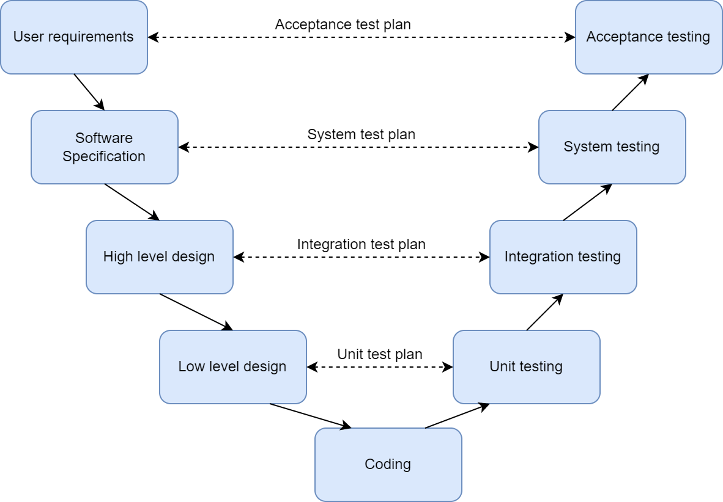
Verification
V & V in Testing
Fig: V-Testing

Slide 14
ANY QUESTION ?
THANK YOU !

Slide 15
Acknowledgements
Acknowledgements
[1] Chauhan, Naresh. Software Testing: Principles and Practices. Oxford university press, 2010.

